Slide 1
Mancala game

Slide 2
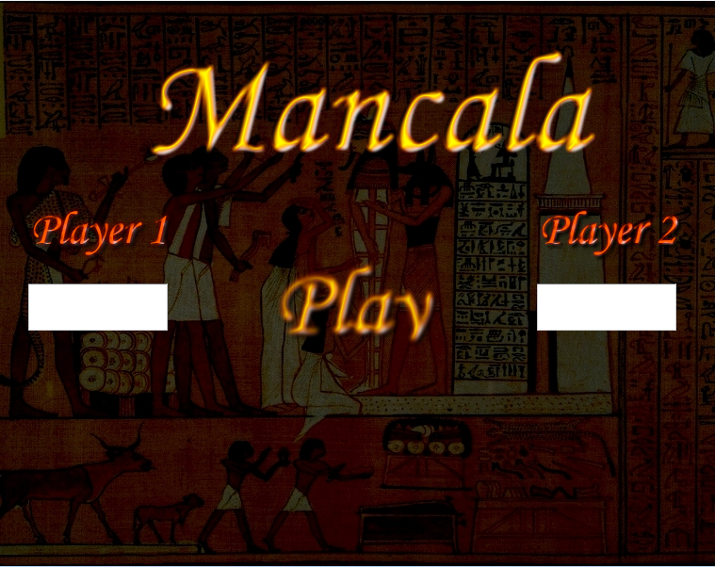
Game design 1

Slide 3
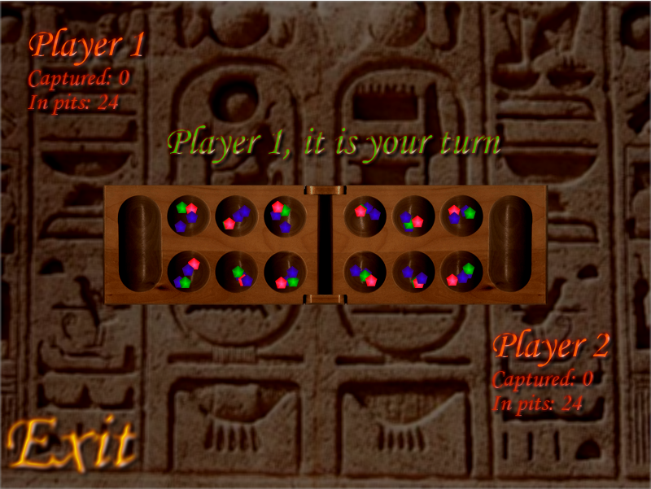
Game design 2

Slide 4
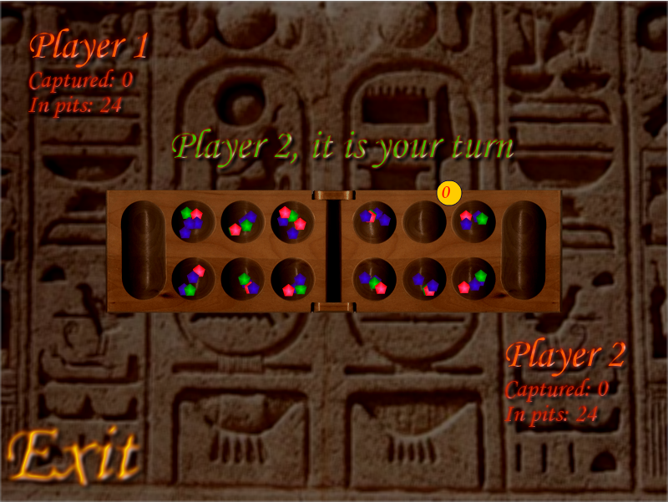
Game design 3

Slide 5
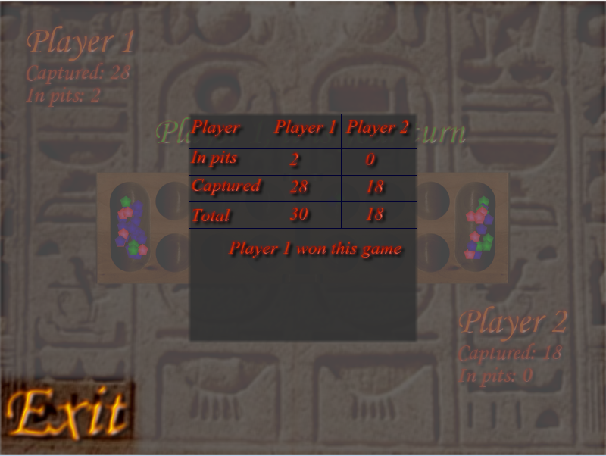
Game design 4

Slide 6
Pattern choice
MVC (Model View Controller) pattern
Singleton pattern
Chain of responsibility pattern

Slide 7
Classes
Initializer.as
GameController.as
GameModel.as
GameView.as
EventHandler.as

Slide 8
Thank you for your attention

